Slide 1
A life course approach to intergenerational family relations
Institute of Social Sciences, Tallinn University
14 November 2024
Pearl A. Dykstra

Slide 2

My talk is based on a recent chapter
Dykstra, P. A., & Fokkema, T. (forthcoming). A life course approach to intergenerational family relations. In M. Albertini (Ed.), Handbook on intergenerational relations. Edward Elgar.
Five key principles from the life course perspective:
(a) timing of lives, (b) lives in context, (c) past shaping present and future, (d) linked lives, and (e) agency

Slide 3
Timing of lives

Slide 4
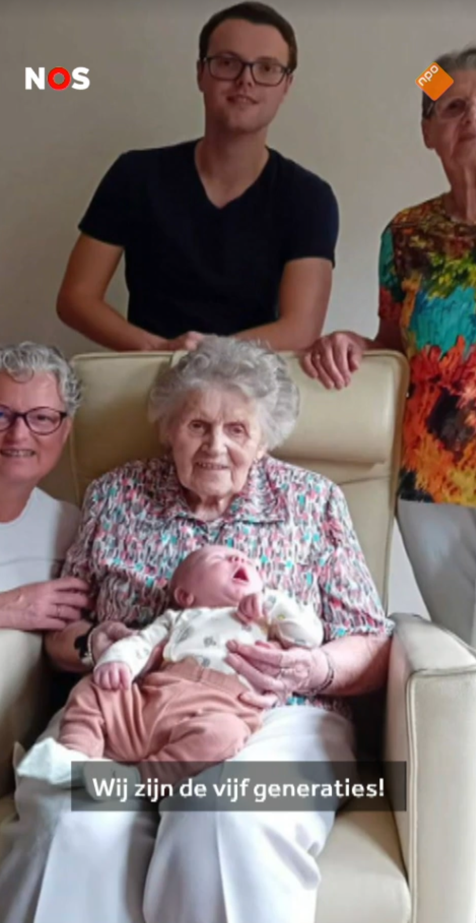
We are the five generations!
7 September 2024

Slide 5
Timing of fertility and mortality: how many family members are co-surviving
Majority of adults are members of three-generation families (Hünteler, 2022)
As people age, their needs for support evolve as do their opportunities to provide help
Separate bodies of literature: transition to adulthood / later stages of life
‘Flow reversal’ of support is parent-driven (Kalmijn, 2019)
Life transitions might alter intergenerational relations
Nevertheless, more continuity than change (Hogerbrugge & Silverstein, 2015)

Slide 6
Studies of family typologies show significant changes for only two life events (Schenk & Dykstra, 2012)
Parental repartnering prompts a shift toward the discordant type
Moving away prompts a shift from the ambivalent type

Slide 7
Lives in context

Slide 8
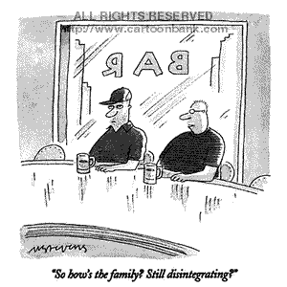
© The New Yorker

Slide 9
Weakening of intergenerational family ties over time?
Increased labour force participation of women (less time for kinkeeping)
Increased geographic mobility (more difficult to maintain contact)
Increased rates of divorce (more severed ties)
Individualization (affection replaces obligation)

Slide 10
What do empirical studies tell us?
Changes in adult child-parent contact over time
Country | Years | Outcome | Author(s)
CH | 1977, 1999 | Increase weekly family visits | Vollenwyder et al. 2002
NL | 1992, 2002 | Increase support to adult children | Van der Pas et al. 2007
GB | 1986-1999 | Decline weekly visits adult children | Murphy 2004
BE | 1985, 2001 | Decline weekly visits adult children | Vanderleyden et al. 2003
AT, DE, GB, IT, US | 1986, 2001 | Increase contacts with adult children | Kalmijn et al. 2009
AT, AU, DE, GB, HU, IT, US | 1986, 2001 | Increase contacts with adult children | Treas et al. 2012
DE | 1996-2014 | No change frequency contacts, emo closeness | Steinbach et al. 2020

Slide 11
No clear understanding of why findings show little weakening of intergenerational family relations
Demography? Smaller families bring greater opportunities to develop close ties?
Welfare state policies? Governments appealing to families to take on more support tasks?
Ideological change? Has rising egalitarianism reduced hierarchy and authoritarianism in families?

Slide 12
Intergenerational family ties and geographic location
Three models of the division of state-family responsibilities (Dykstra, 2018)
Crowding out: welfare state provisions replace family care
Crowding in: welfare state provisions enable redistributions at the family level
Specialization: the state and families do the tasks for which they are best equipped
Example: adult children supporting their ageing parents

Slide 13
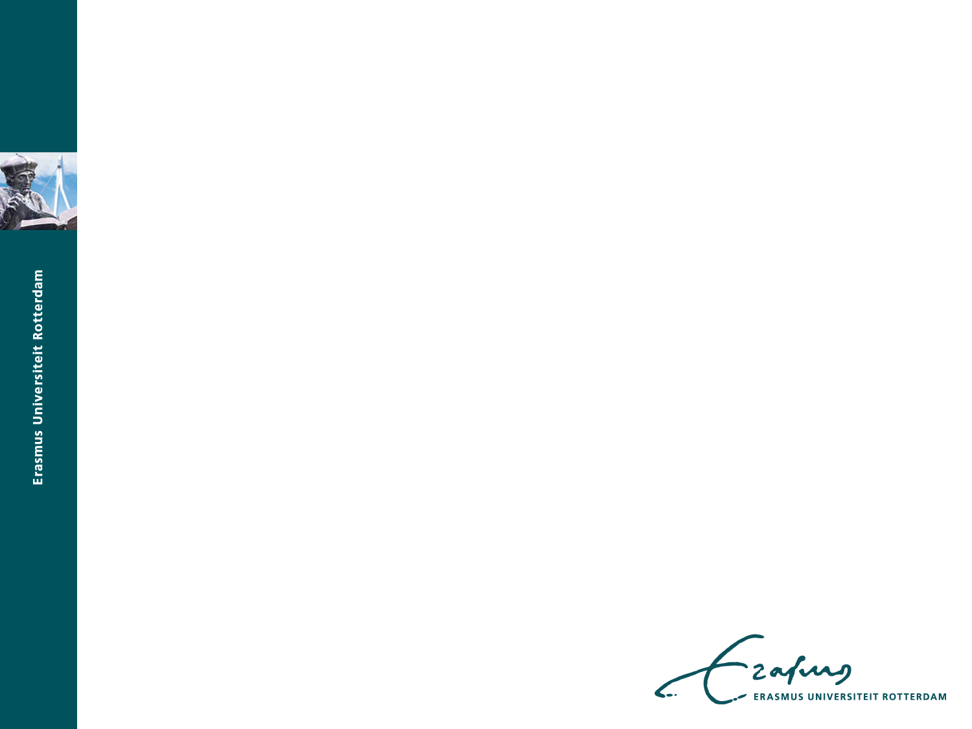
% 50+ providing care to elderly parents
Source: Brandt et al. (2009), based on SHARE

Slide 14
% 50+ providing help to elderly parents
Source: Brandt et al. (2009), based on SHARE

Slide 15
Past shaping present and future

Slide 16
Insights from longitudinal studies on intergenerational exchanges in families
Development of morally binding obligations and expectations (research is rare)
Young adults develop sensitivity to the needs of ageing parents through their earlier connection to grandparents (Hwang et al., 2022)
Older adults expect to receive sick care from their adult children if they have exchanged instrumental support with them (Lin & Wu, 2014)
Reciprocity in adult child-parent relations over the life course (plethora of research)
Past support is a good predictor of support exchanges later in the life course (e.g. Tur-Sinai et al., 2020)
But, there is also empirical backing for altruism (Wade-Benzoni et al., 2009) and family obligations (Mazzotta et al., 2020)

Slide 17
Linked lives

Slide 18
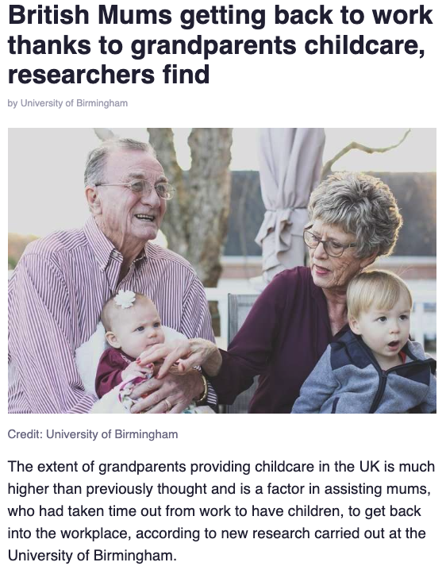

Slide 19
New insights gained by considering lives linked across family generations
Decision to have children is taken more readily when support from
grandparents is anticipated (e.g. Pink, 2018)
Caring for a parent reduces the probability of remaining in the labour force, and more strongly so for men than for women (e.g. Heger et al., 2020)
Providing regular grandchild care increases the exit risk for both men and women, and more strongly so in countries with poorer childcare infrastructure (Bertogg, 2023)

Slide 20
Agency

Slide 21
Ways in which welfare arrangements shape autonomy between family generations (Dykstra et al., 2016)
Nations can:
Mandate interdependence (e.g. maintenance laws)
Block interdependence (e.g. immigration and refugee policies)
Generate interdependence (e.g. ‘daddy quota’)
Lighten interdependence (e.g. daycare, pensions)
Compel interdependence (through lack of provisions)

Slide 22
Wrapping up

Slide 23
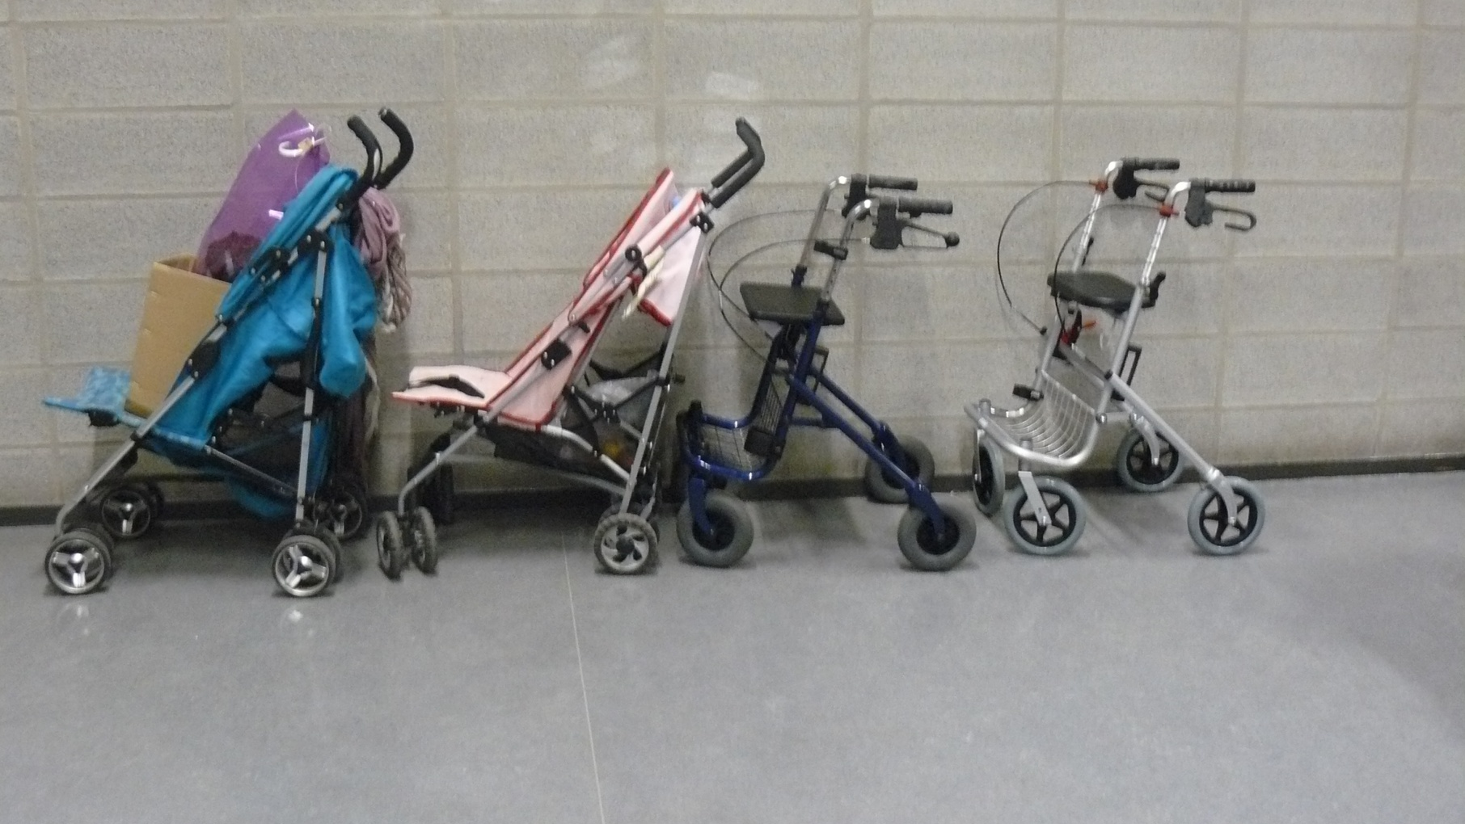

Slide 24
Few studies on intergenerational family relations cover the entire life course
The separation of the literature in ‘young’ and ‘old’ sections is unfortunate
There is a
Disregard for similarities in the needs of young and old family members (Dykstra & Komter, 2012)
Neglect of the fact that young and old come from different cohorts (Suitor et al., 2016)
Problem of reporting biases due to an underrepresentation of frail older people in parent data but not in adult child data (Kalmijn, 2019)

Slide 25
It is important to
Acknowledge that not everyone is embedded in intergenerational family networks (‘generational solos’)
Study the family ties of those whose lives do not follow culturally normative patterns (‘off-time’, non-heterosexual, migrant, and so forth)

Slide 26
There are reasons to question the supposed matrilineal tilt in families
Do not underestimate the demographic and societal trends that favour maternal grandmothers
Do not overlook the rise of the emotionally involved fathers and grandfathers

